Slide 1
Motivations for development of a new cuvette design
We have found that the cuvettes for both the benchtop and V5 mesospim are a limiting factor for its general use both in individual labs and in a core environment for many reasons.
The solutions that are used for imaging are commonly not “pleasant” or may be corrosive to the microscopes if they spill (DBE, BABB) and users are clumsy
The current quartz cuvettes are expensive and unless “custom” are generally too small for larger samples
Correcting for Astigmatism and moving/exchanging cuvettes is difficult
Ideally we should be able to have many cuvettes with a storage solution that minimizes the chance of cross contamination or spilling.
The walls of the quartz and glass cuvettes are quite thick so any RI mismatch issues are exaggerated
Did I say they are expensive ☺

Slide 2
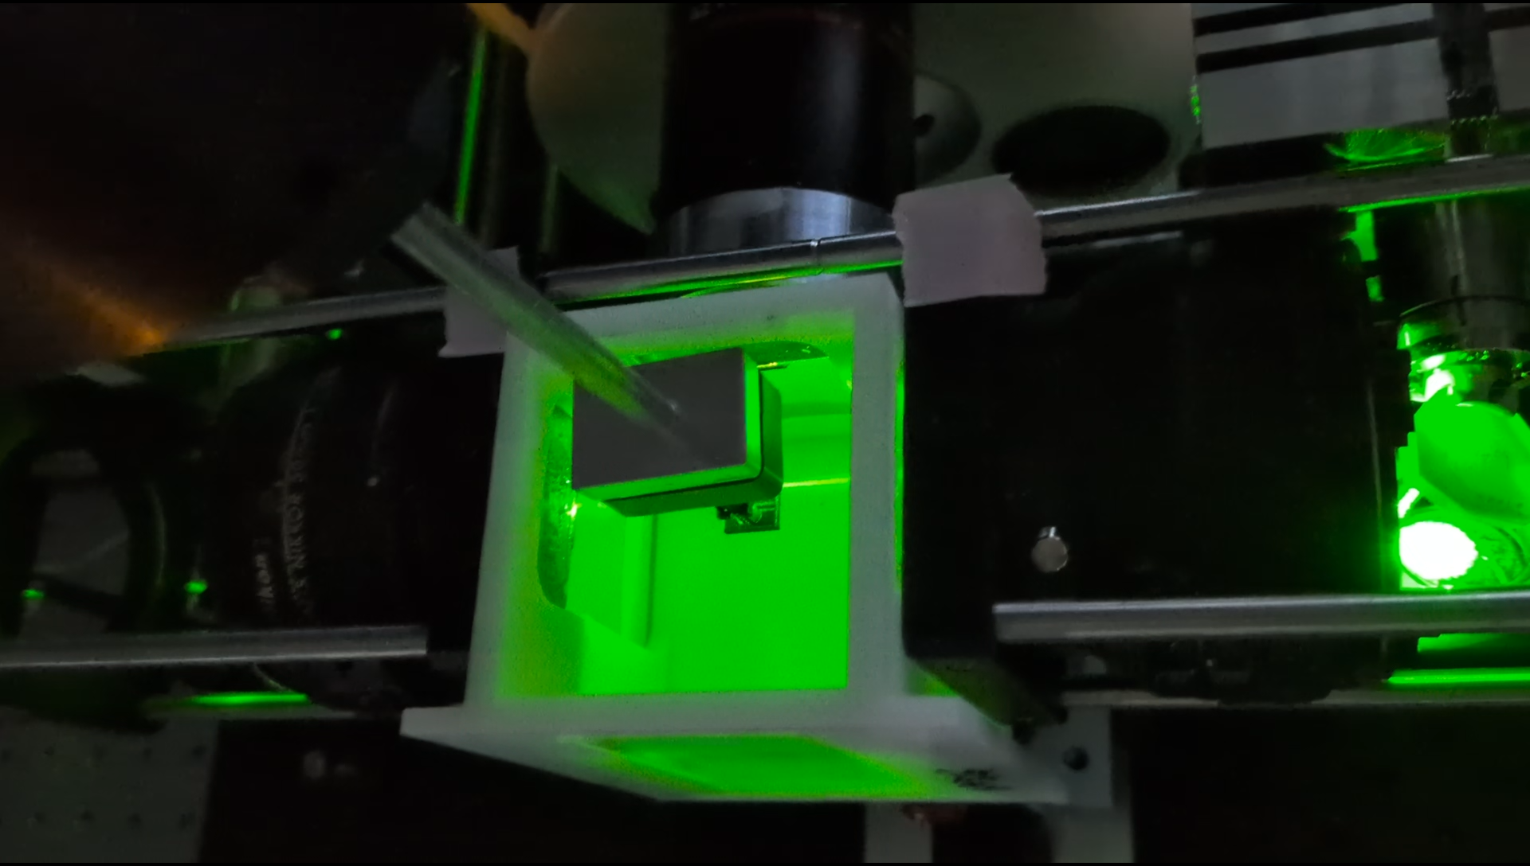
Ideally the Cuvette design should be very inexpensive, easily exchanged, difficult to spill, able to accommodate larger samples, and have minimal effect on the light sheet path through the sample.
Our design uses
conventional 3D printing
inexpensive camera mounts such that quick exchange and storage of cuvettes is possible,
there is no possibility for astigmatism,
it is possible to minimize spherical aberration by correct cuvette placement in the imaging optical path

Slide 3
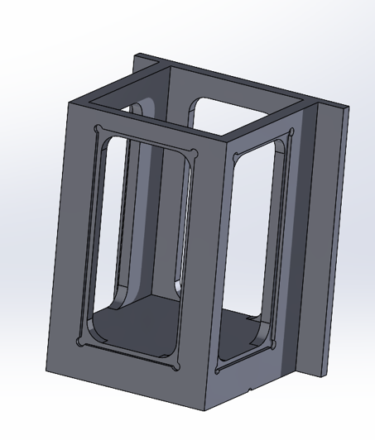
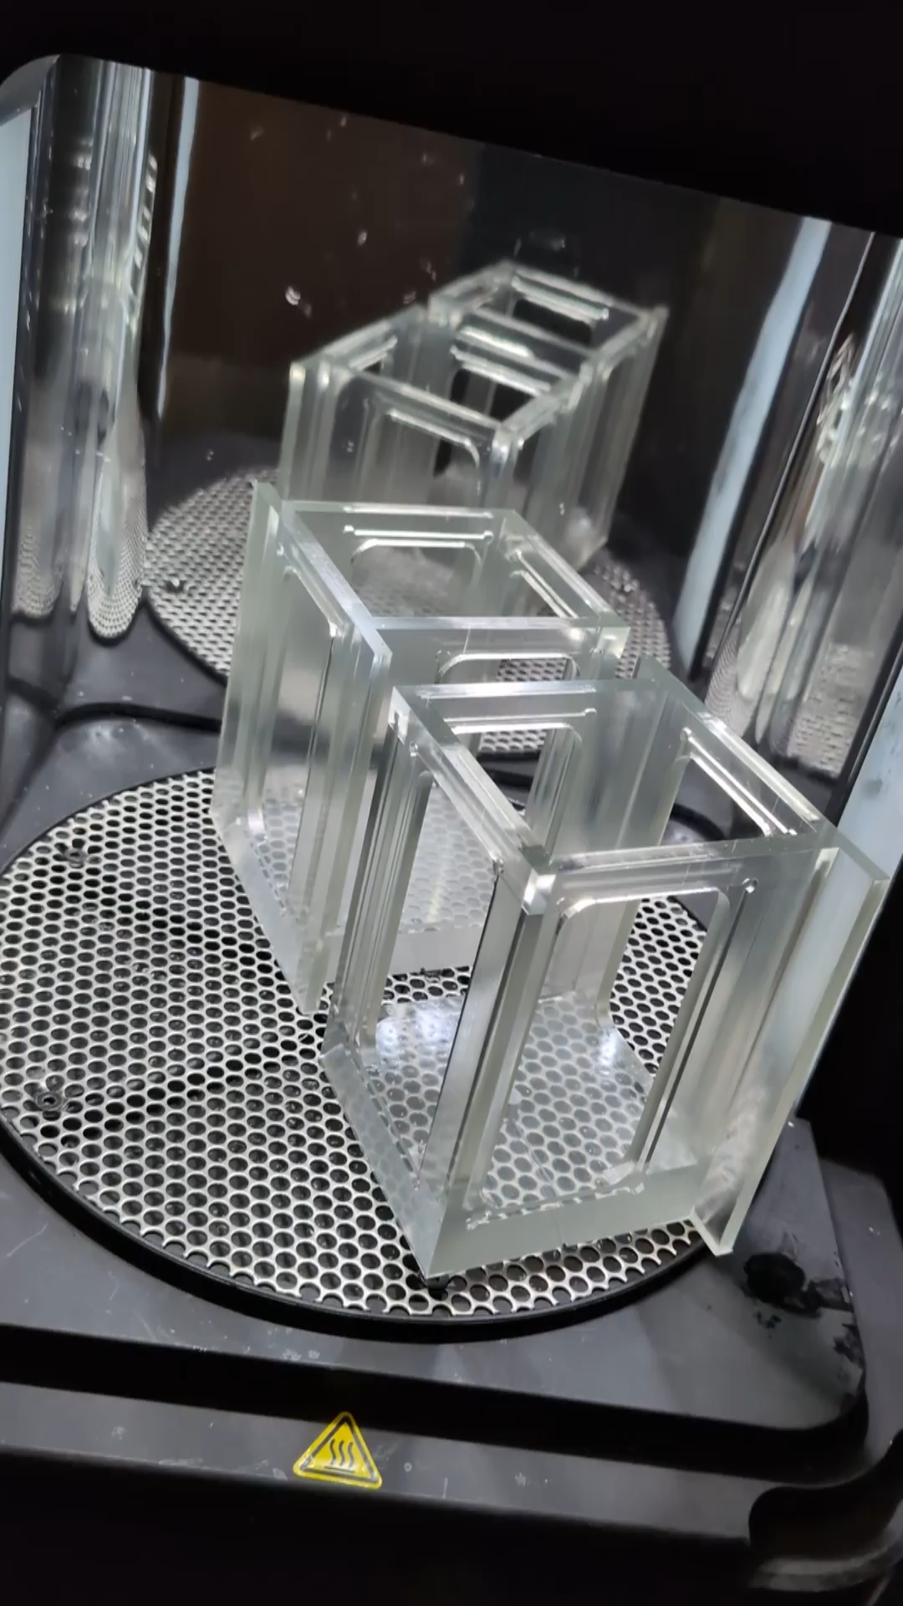
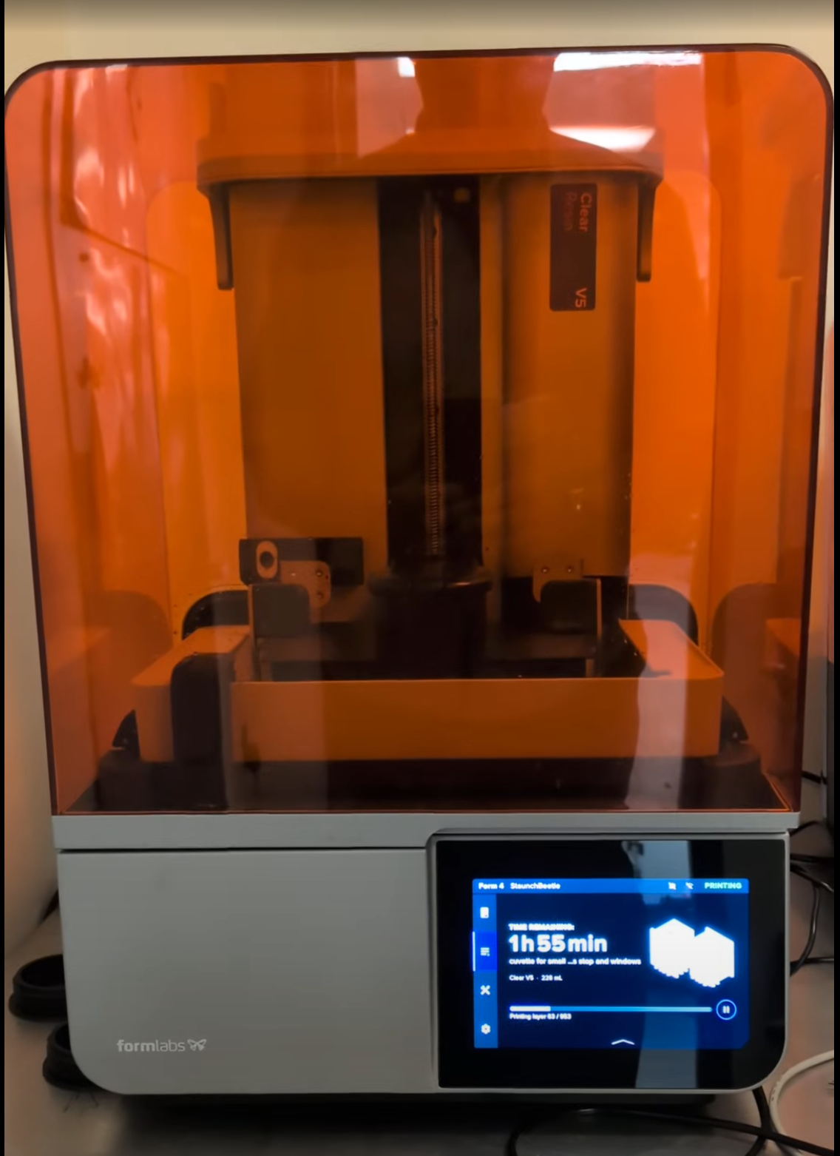
Cuvette #1 design
Designed in SolidWorks
Printed with Formlabs4 printer
Printed with Clear V5 resin
Supports are removed and the resin cured (essential)
The post mount is tapped after the cuvette is printed and cured
We use 100% silicone to adhere the windows
Windows are 50x25 (double wide) super-frost slides
We have had only one fail after 2 months in DBE due to poor silicone use.
Design is available on Image SC forum.

Slide 4
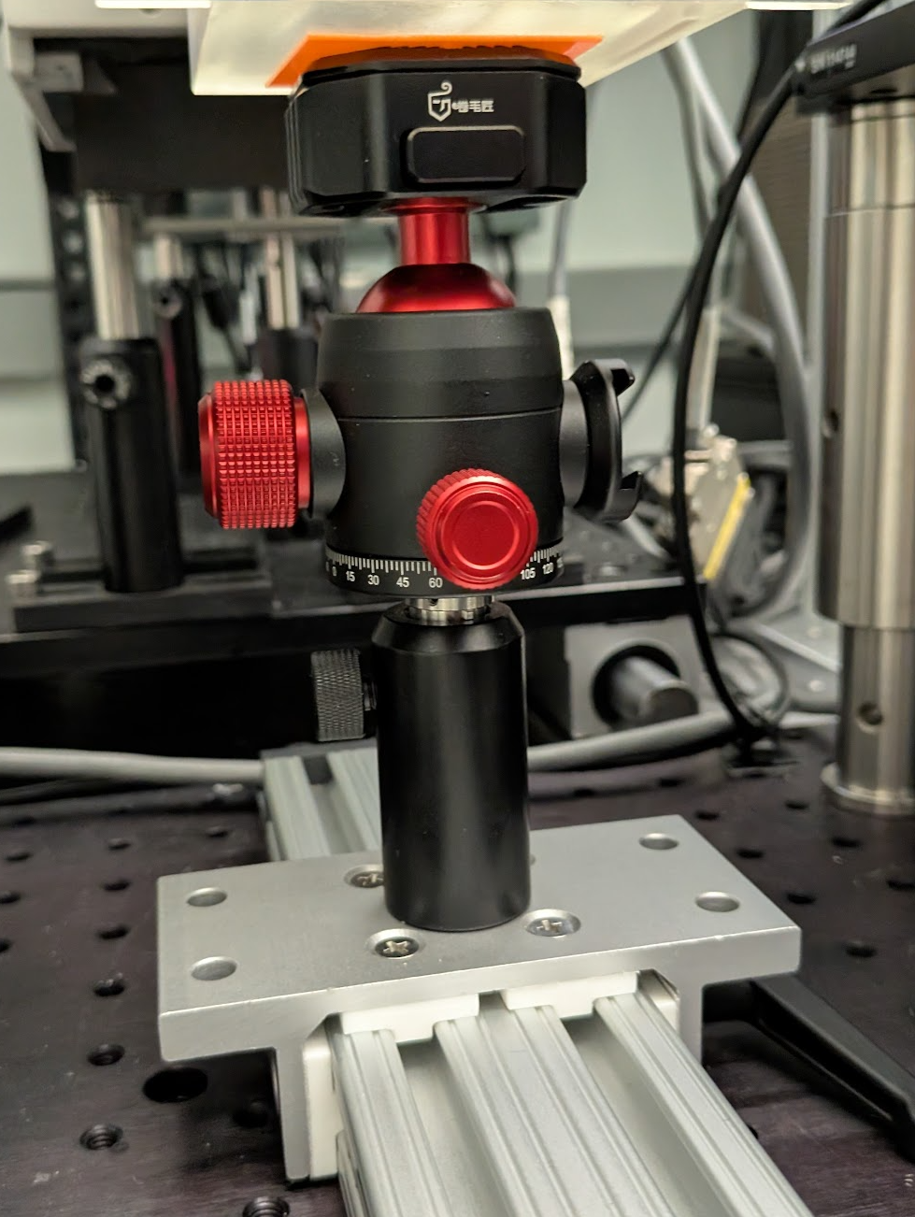
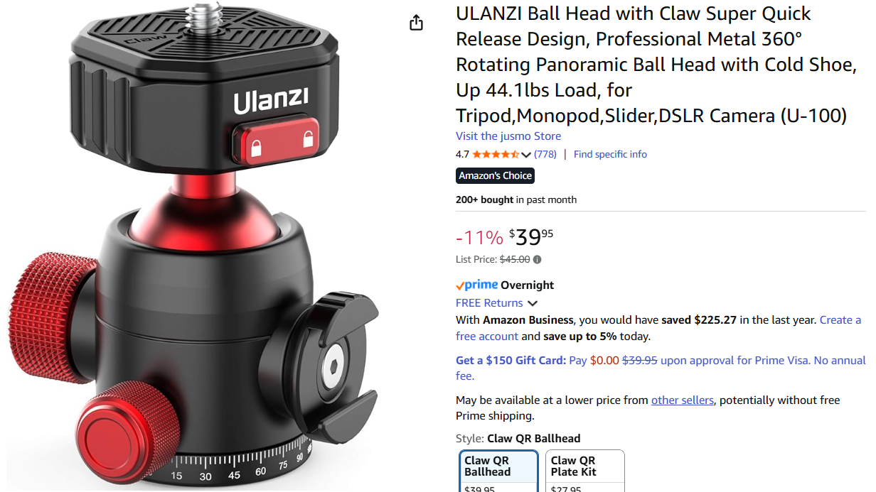
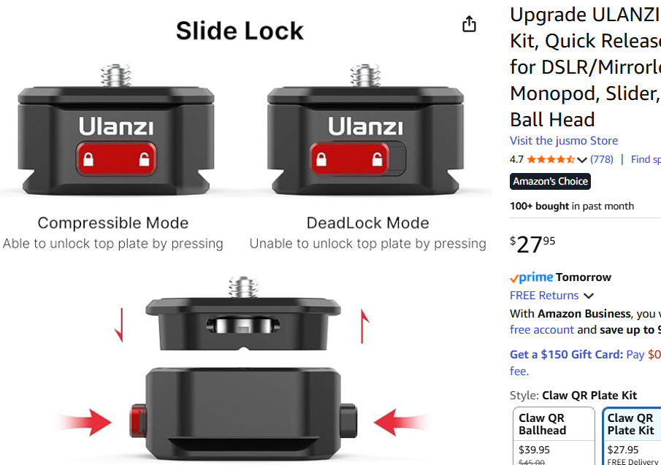
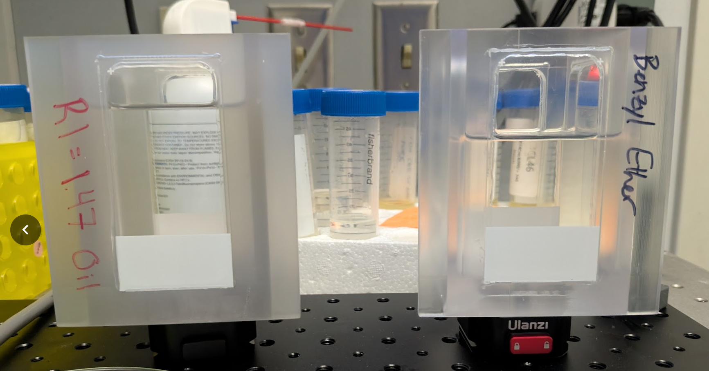
Cuvettes #2 Mounting
Needed to have easy cuvette exchange
Used conventional quick release camera mounts
Quick release mounts used for Cuvette storage

Slide 5
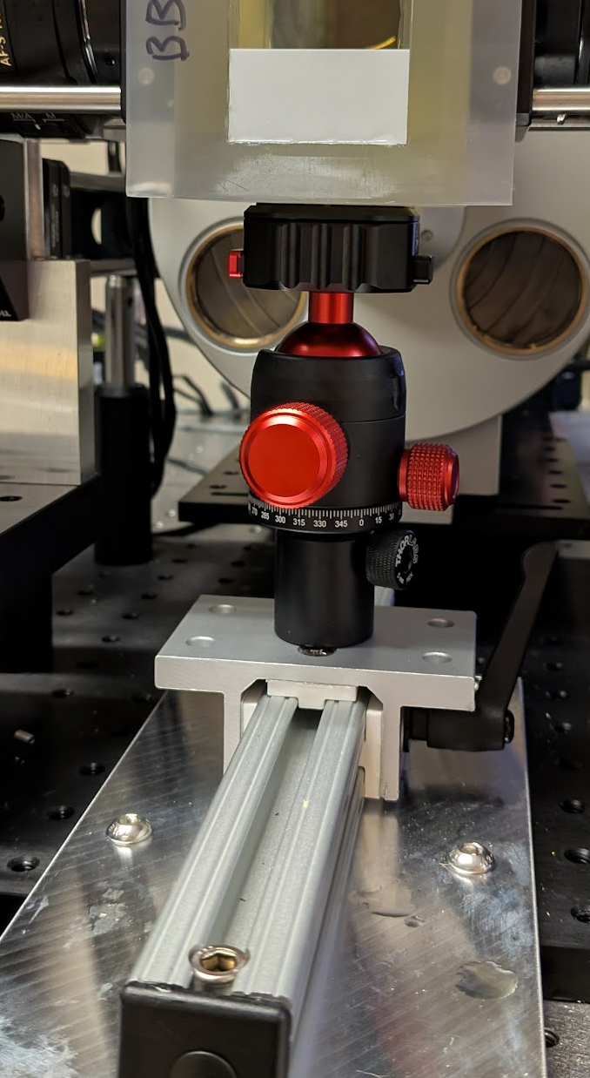
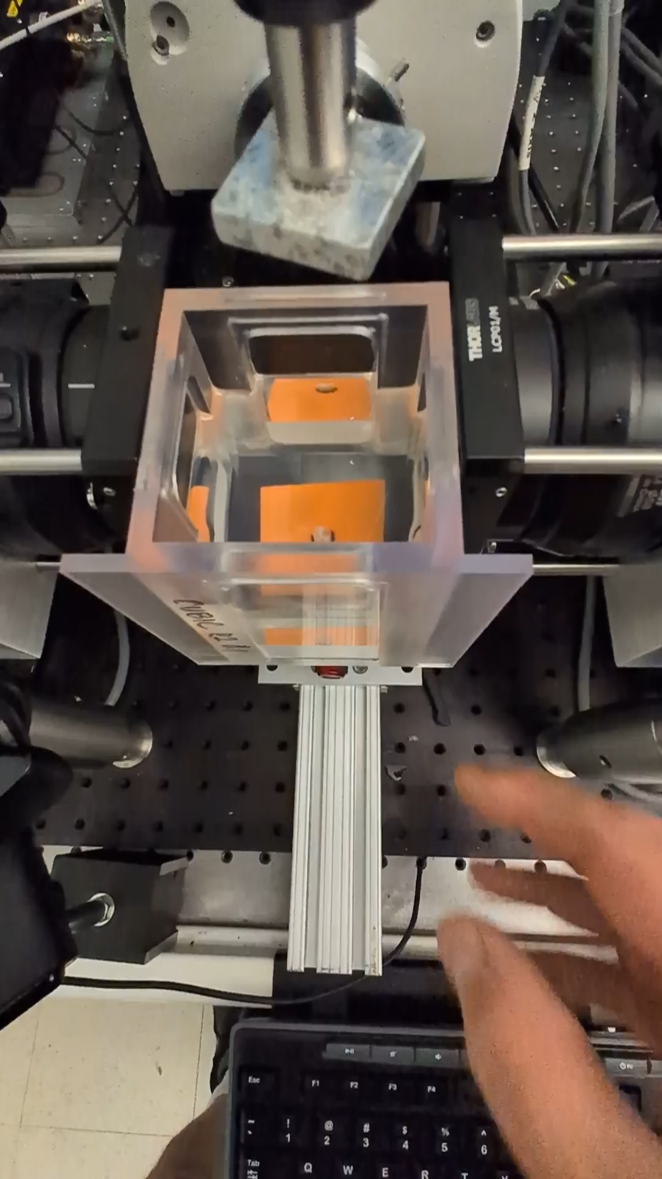
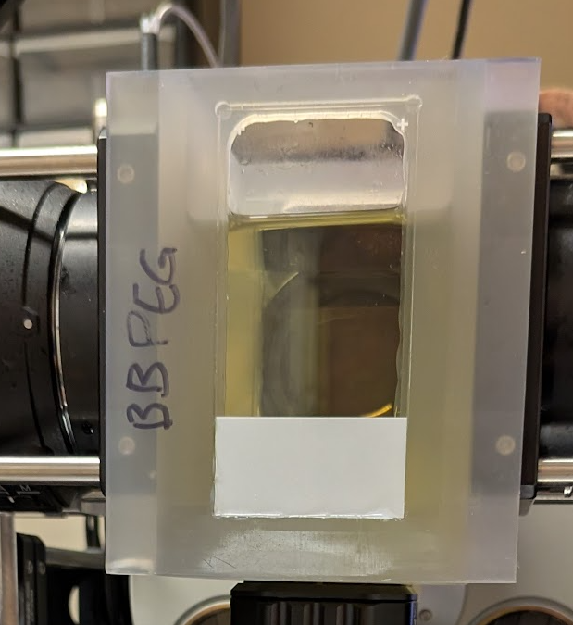
Cuvette#3 exchange
Cuvettes slide snugly between the two illumination lenses and the back plate ensures they are vertical
No Pitch/Yaw etc
With a locking arm
Cuvette track is conventional 80/20

Slide 6
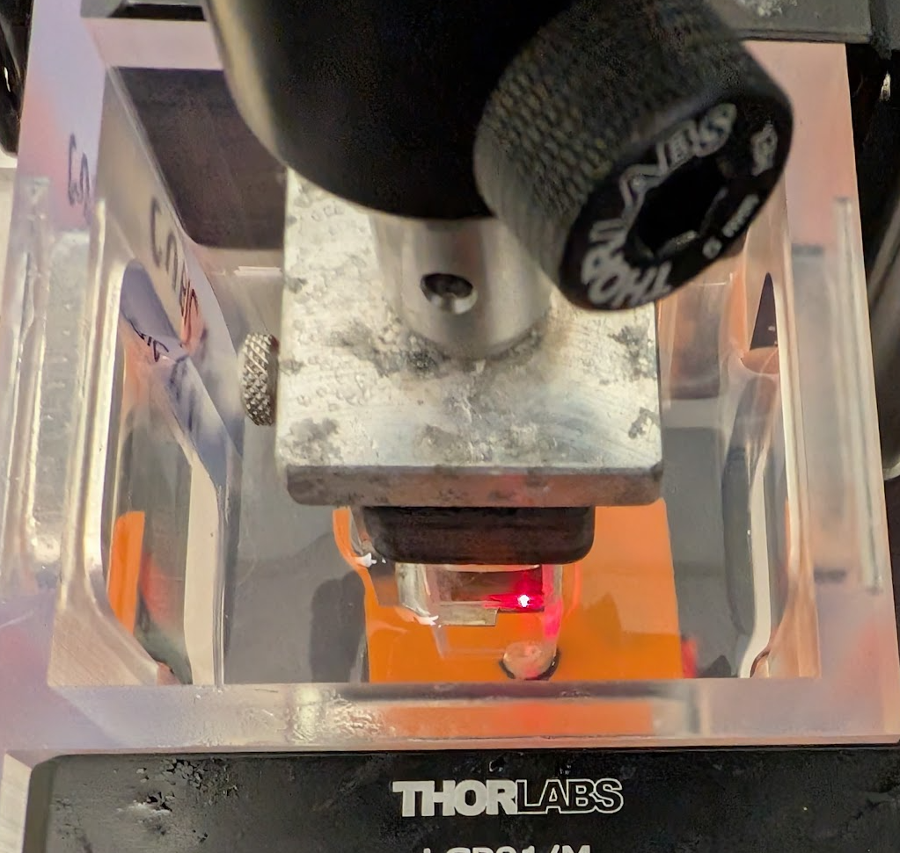
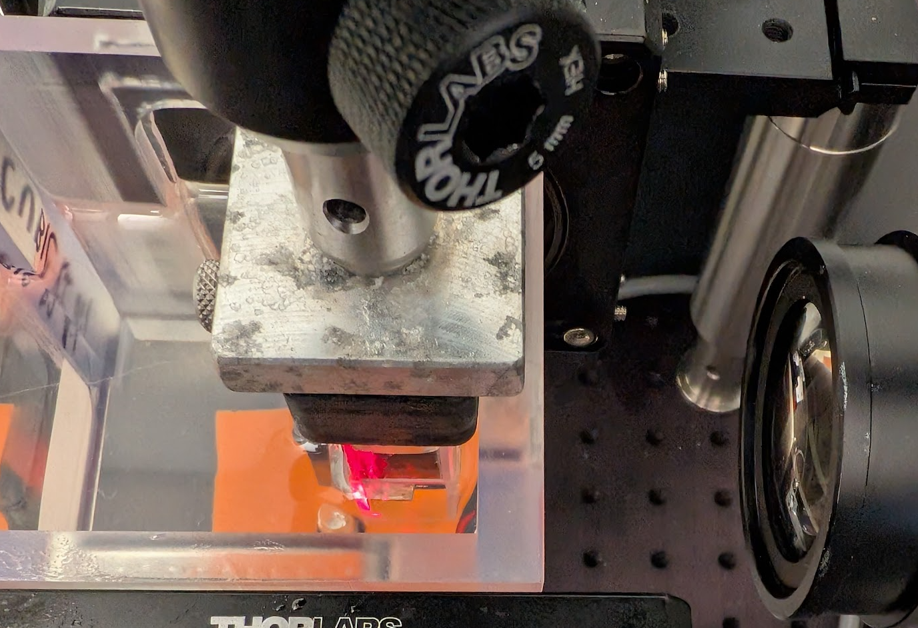
Cuvette #4 positioning
To minimize SA with air lenses it is important to have as little transition fluid between the lens and the sample. Because the cuvettes slide and keep orientation this is easy
Sample in cuvette in microscope, illuminate the bak of the sample
move cuvette back so its almost touching the sample and maximize the air gap
Refocus the sample and image. Because the cuvette is essentially locked in XYZ the ETLs will be pretty much unchanged but focus will need to be reset

